Slide 1


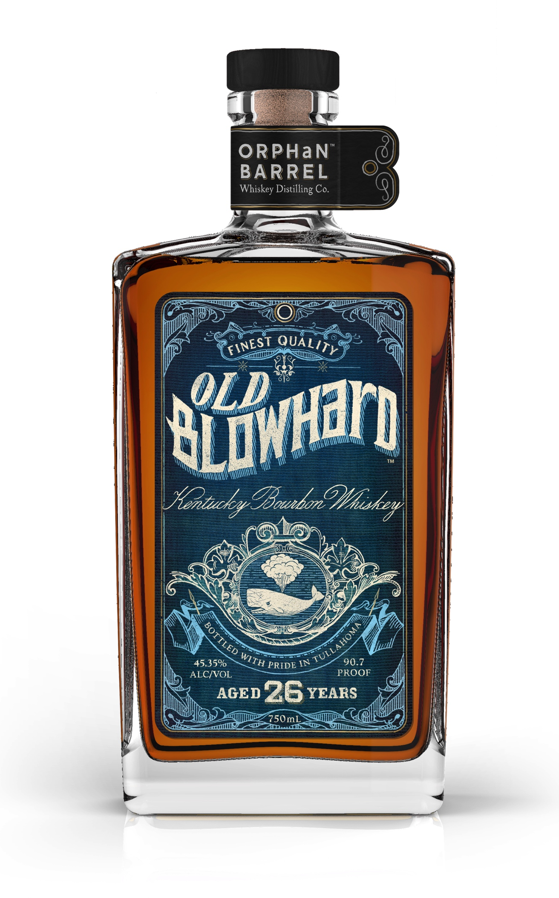
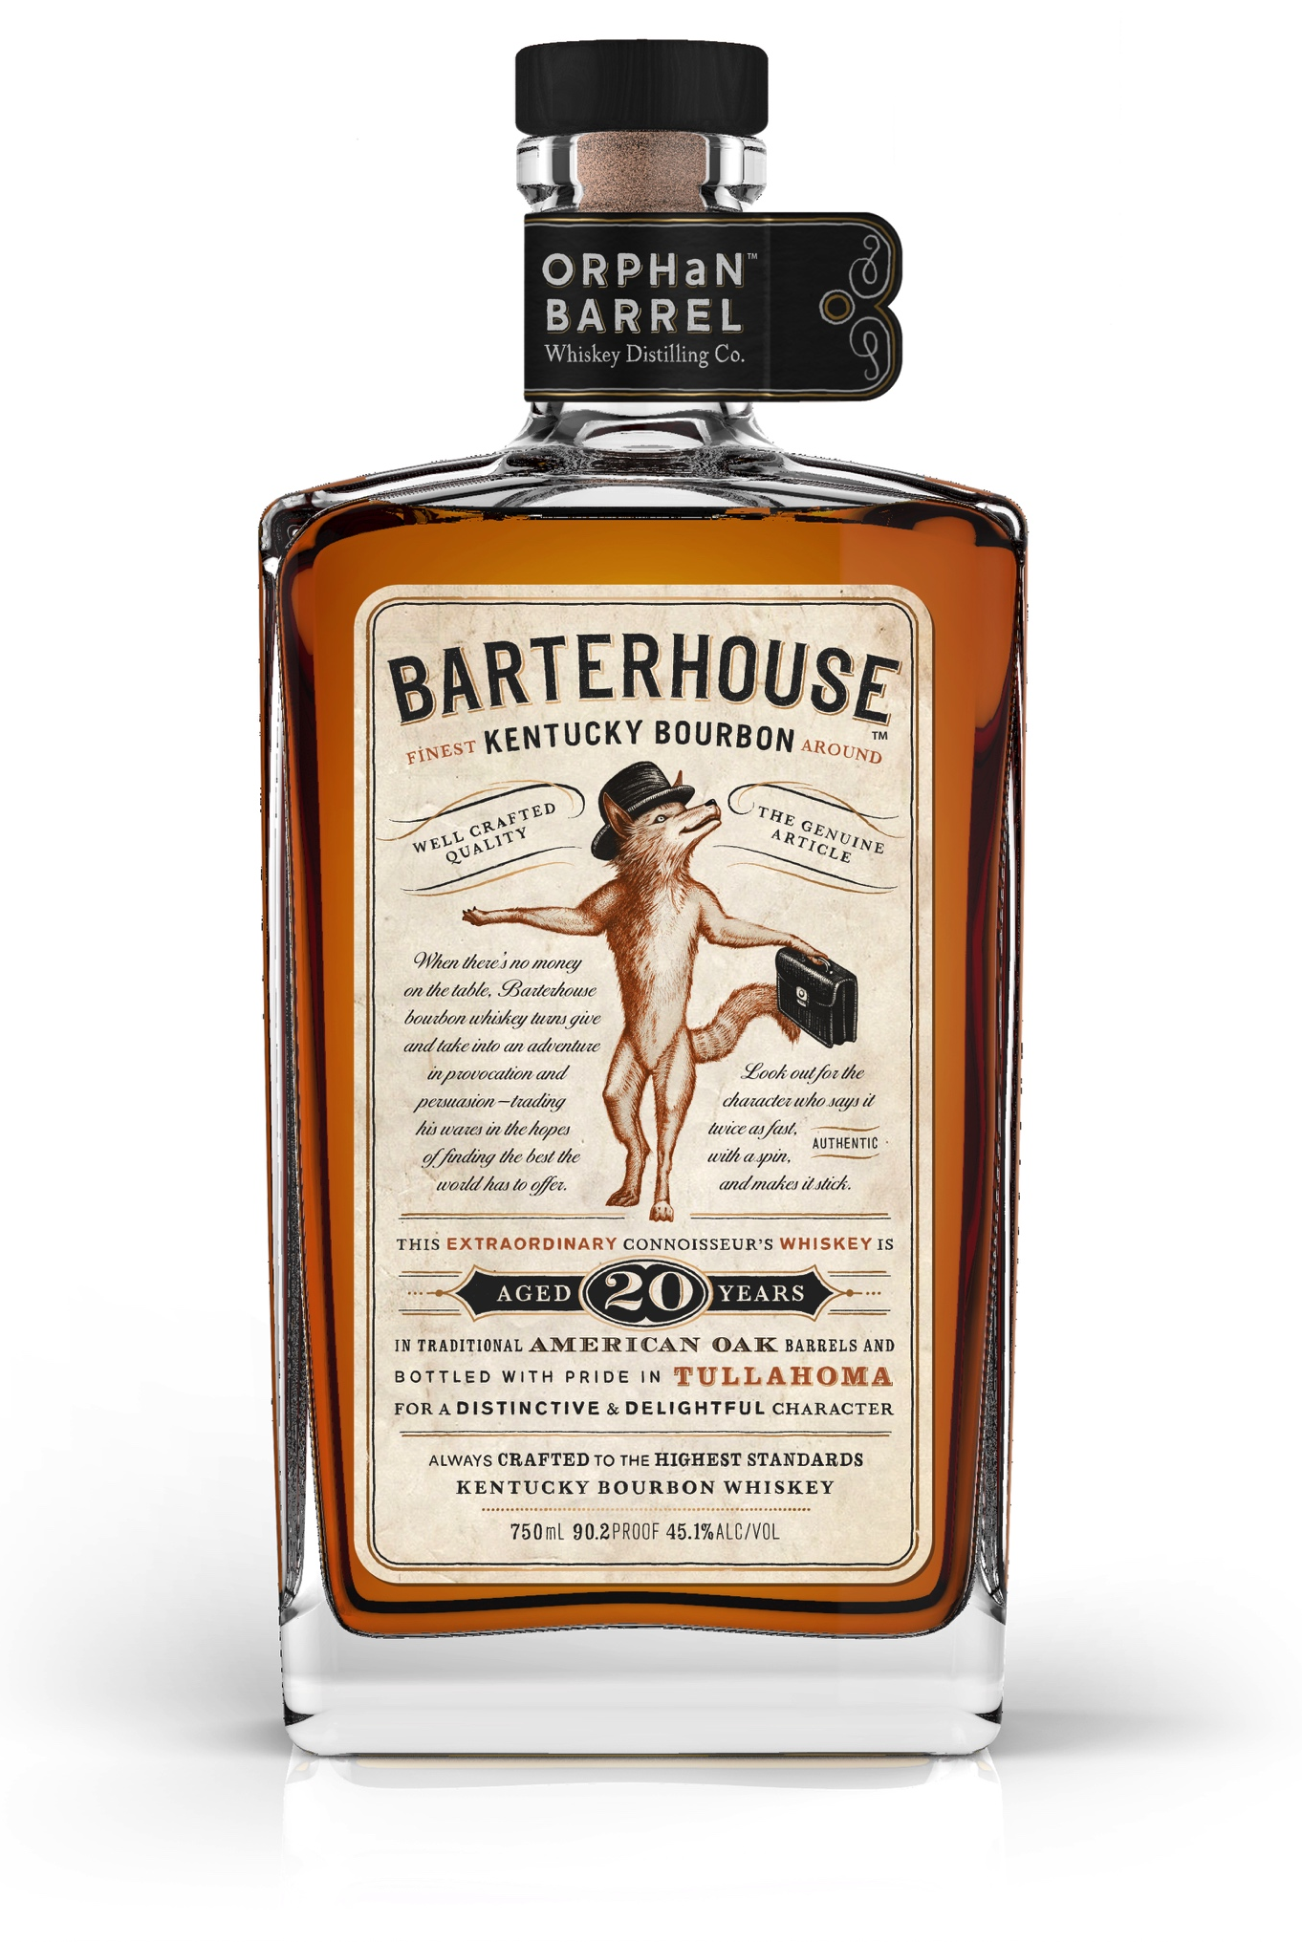
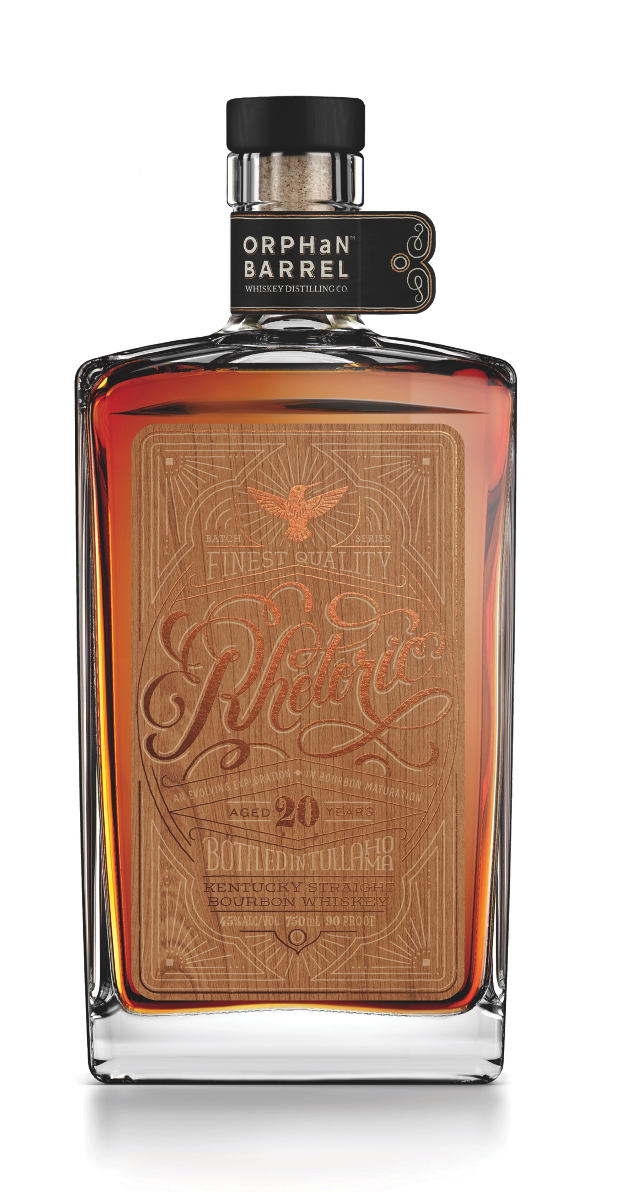
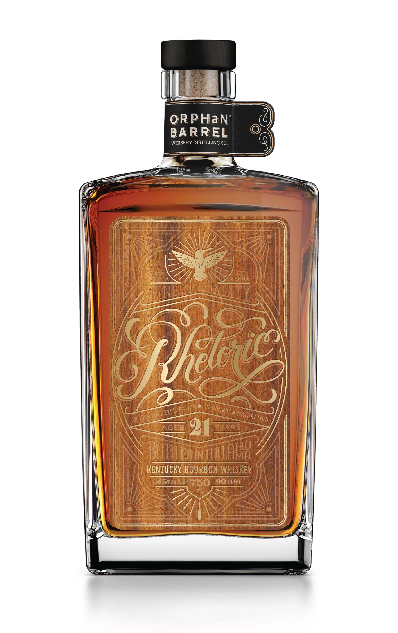
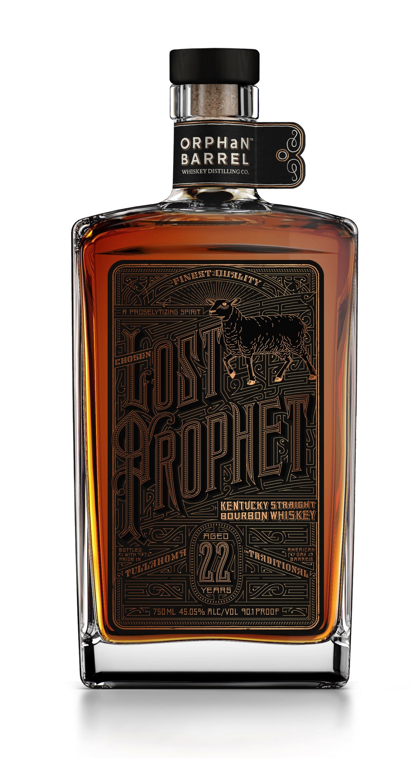
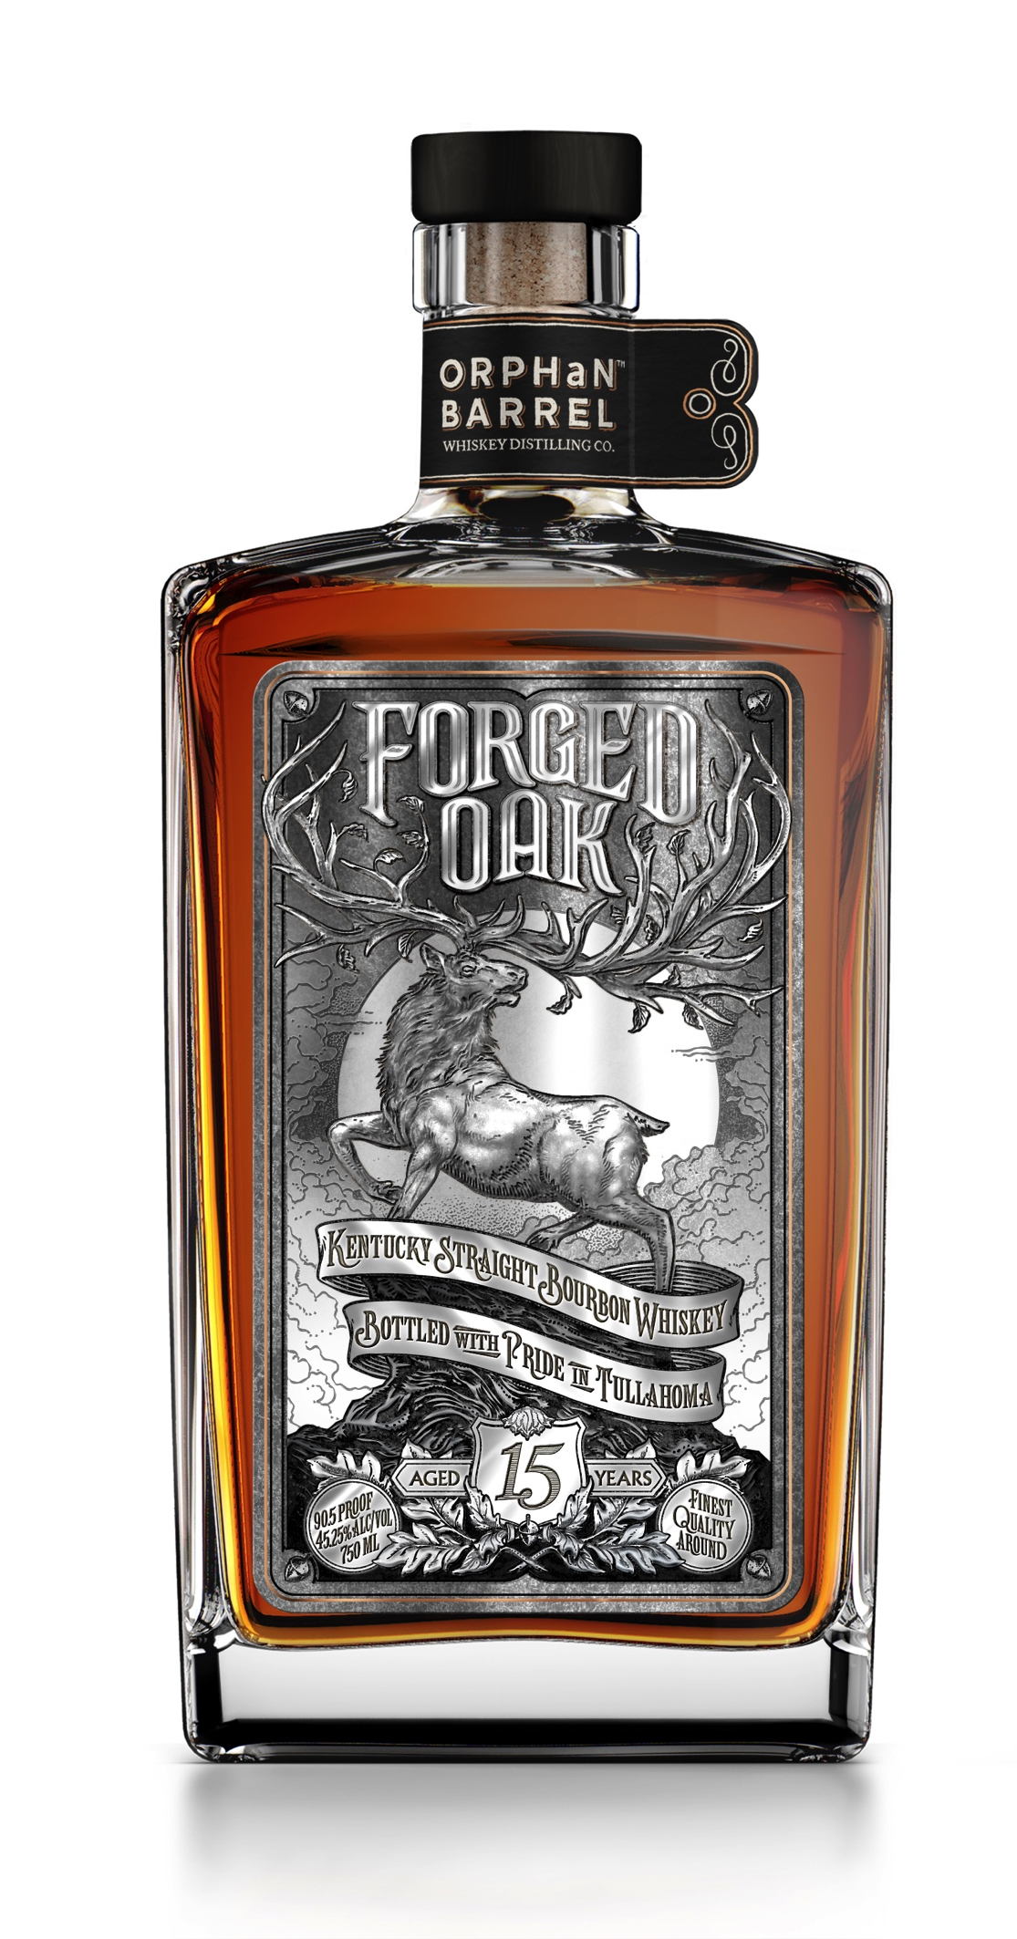
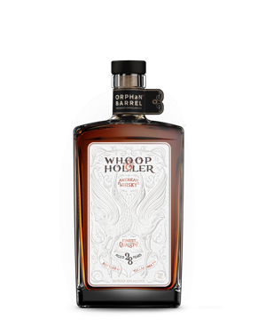
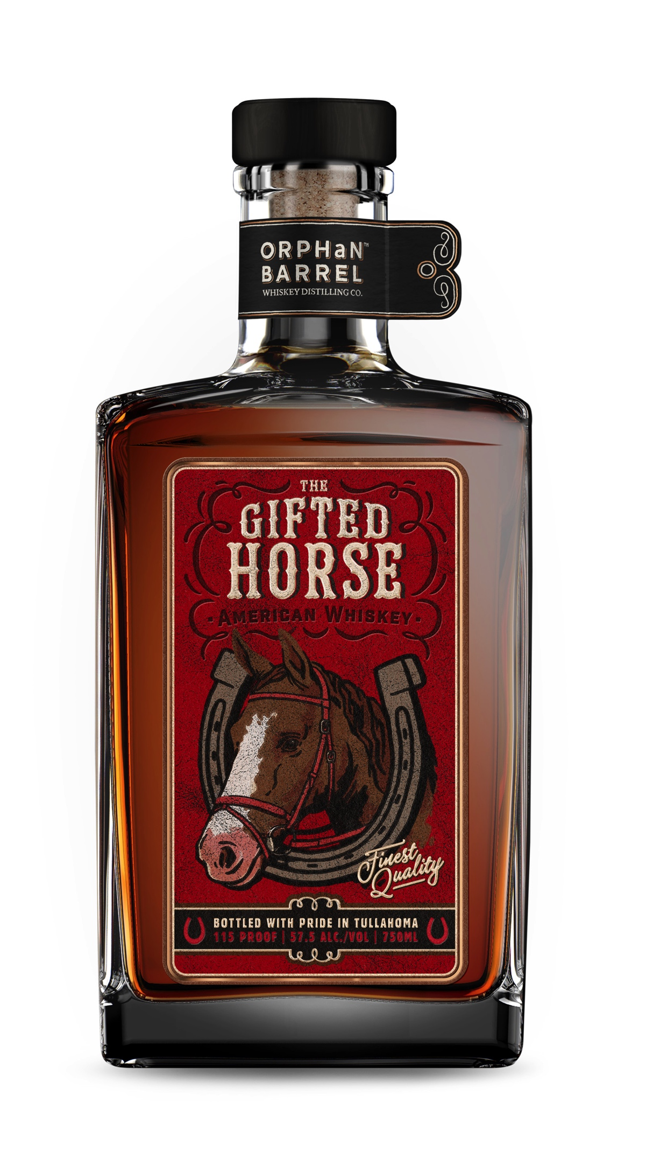
The ULTIMATE RARE WHISKEY EXPERIENCE
This Fantasy Gift is proudly brought to life by the Orphan Barrel Whiskey Distilling Co., who finds long-forgotten whiskeys from the darkest corners of rickhouses and distilleries to share these legendary liquids with whiskey aficionados.
The WHISKEY
The purchaser will receive 24 bottles of all six Orphan Barrel bourbons released to date: Old Blowhard 26-year-old, Lost Prophet 22-year-old, Rhetoric 21-year-old, Rhetoric 2o-year-old, Barterhouse 20-year-old and Forged Oak 15-year-old.
The BARREL HUNTING TRIP The purchaser and five guests will take a luxurious trip to the legendary Stitzel-Weller Distillery in Louisville to taste recently-discovered bourbons and participate in the hands-on guided creation of two completely unique Orphan Barrel bourbon variants. 24 bottles of each bourbon will be hand-bottled with custom labels and signed by the purchaser, never to be bottled again, for anyone else.
The Stitzel-Weller Distillery is a cathedral of bourbon and a must-visit destination on the Kentucky Bourbon Trail® tour.
The BESPOKE WHISKEY CABINET This elegant furniture piece was built by hand in Louisville by craftsman Jason Cohen, using reclaimed American oak pulled from rickhouses at the Stitzel-Weller Distillery, copper finishes from Vendome Copper & Brass Works, St. Louis crystal tumblers and copper-finished bar tools.
www.orphanbarrel.com
Instagram: @orphanbarrel
Old Blowhard 26-Year-Old Kentucky Straight Bourbon: Old Blowhard is one of the first releases from the Orphan Barrel Distilling Company. The ample time in storage contributed to the whiskey’s exuberant, rich flavors with undertones of smoke and honey followed by a gentle finish – dry and spicy with a hint of orange peel.
Barterhouse 20-year-old Kentucky Straight Bourbon: Barterhouse is one of the first releases from the Orphan Barrel Whiskey Distilling Company. Beginning with a soft and elegant nose reminiscent of warm spice, biscuit and buttercream, Barterhouse pays off cunningly with a mellow taste of roasted grains and charred oak.
Rhetoric 20-Year-Old Kentucky Straight Bourbon: Rhetoric 20-Year-Old is the first in a series of progressively aged bourbons that will be released over the coming years. Rhetoric tastes of smoked vanilla, toasted rye and dried fruit before a long full finish of cherry blossom and bitter chocolate.
Rhetoric 21-Year-Old Kentucky Straight Bourbon: Rhetoric 21-Year-Old is the second in the Rhetoric series of progressively aged bourbons. Aged one year longer than its counterpart, this release is slightly more mature and carries a higher proof with tastes of charred wood, black pepper spice, dark chocolate and baking spices before a long, woody finish.
Lost Prophet 22-Year-Old Kentucky Straight Bourbon: Lost Prophet is convincing, eloquent and intense, with a silky, full bodied taste of spice cake, vanilla and leather, with a sweet, smoky finish.
24 Forged Oak 15-Year-Old Kentucky Straight Bourbon: Forged Oak begins with notes of cedar, maple and vanilla bean on the nose and tastes of seasoned woody notes of cocoa and young berries with a long, dry finish of black pepper.
The Gifted Horse
American Whiskey: Beginning with a nose hinting at apple skin, almond, toffee, raisins and slight milk chocolate, The Gifted Horse has unique tasting notes of creamy caramel, Bosc pear and fruit cake. This unusual blend’s fruity notes become more apparent with a splash of water.
Whoop & Holler
An enthusiastic howl of a whisky, with whiffs of corn kernel, tobacco and citrus peel that reveal an aggressive woody oak taste with notes of spicy peppercorn, clove and a whisper of dark chocolate for a long dry finish.
PLEASE DRINK RESPONSIBLY. Orphan Barrel Whiskey. 45-45.4% Alc/Vol. ©2016 Orphan Barrel Whiskey Distilling Co., Tullahoma, TN.

